Slide 1

#LifeKoKaroLift
Post-Graduate Diploma in ML/AI

Slide 2


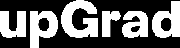
Course : Machine Learning
Lecture On : Pre exam session
Instructor : Manish Kumar

Slide 3
Modules Included
Advanced Regression
Model Selection
Tree Models
Boosting
Clustering

Slide 4
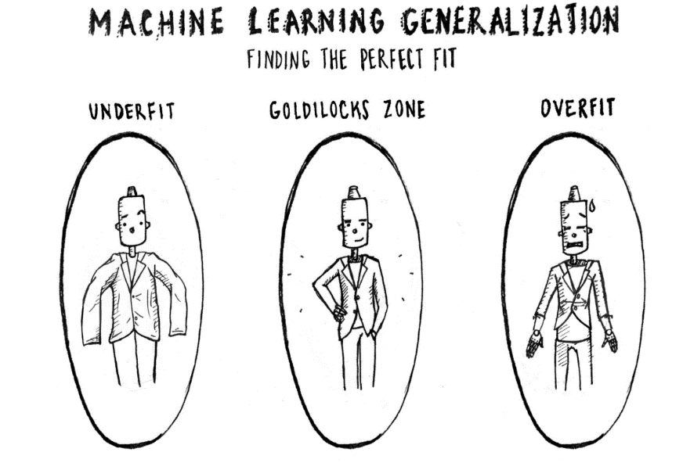
What & Why of Overfitting and Underfitting
Underfitting refers to a model that can neither model the training data nor generalize to new data.
An underfit machine learning model is not a suitable model and will be obvious as it will have poor performance on the training data.
Overfitting refers to a model that models the training data too well.
Overfitting happens when a model learns the detail and noise in the training data to the extent that it negatively impacts the performance of the model on new data. This means that the noise or random fluctuations in the training data is picked up and learned as concepts by the model. The problem is that these concepts do not apply to new data and negatively impact the models ability to generalize.

Slide 5
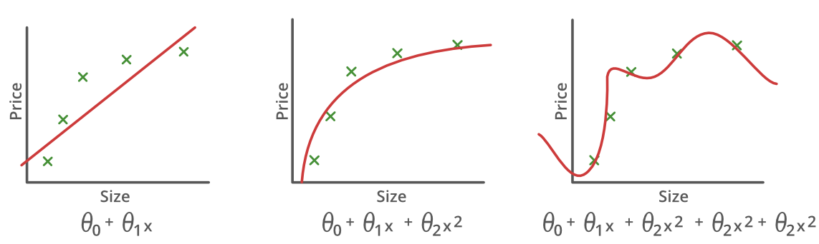
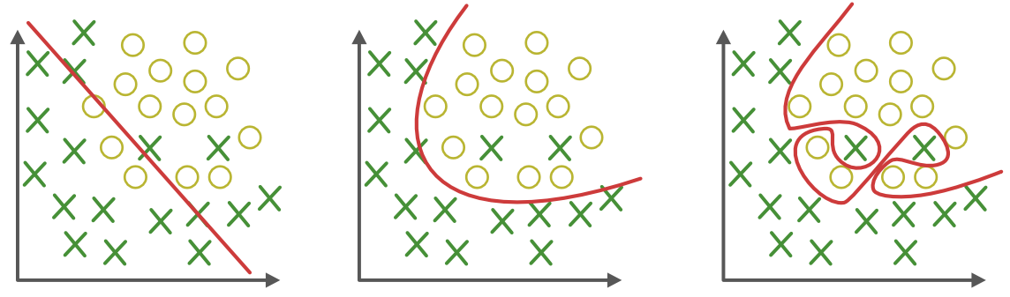
What & Why of Overfitting and Underfitting
Underfitting
Good-Fit
Overfitting

Slide 6
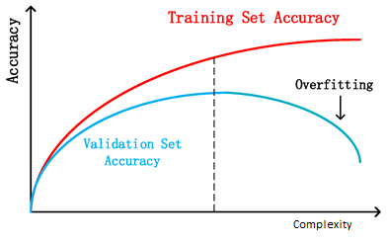
How to Detect Overfitting?
Detecting overfitting is almost impossible before you test the data. It can help address the inherent characteristic of overfitting, which is the inability to generalize data sets. The data can, therefore, be separated into different subsets to make it easy for training and testing. The data is split into three main parts, i.e., a train set ,a test set & a validate set
– Training set: A set of examples used for learning, that is to fit the parameters of the classifier.
– Validation set: A set of examples used to tune the parameters of a classifier, for example to choose the number of hidden units in a neural network.
– Test set: A set of examples used only to assess the performance of a fully-specified classifier.
By segmenting the dataset, we can examine the performance of the model on each set of data to spot overfitting when it occurs. The performance can be measured using the percentage of accuracy observed in train & validate data sets to conclude on the presence of overfitting.

Slide 7




Poll 1
How does number of observations influence overfitting? Choose the correct answer(s)
In case of fewer observations, it is easy to overfit the data.
In case of fewer observations, it is hard to overfit the data.
In case of more observations, it is easy to overfit the data.
In case of more observations, it is hard to overfit the data
A. 1 and 4
B. 2 and 3
C. 1 and 3
D. None of theses
Practice in teams of 4 students
Industry expert mentoring to learn better
Get personalised feedback for improvements
16-07-2020
11

Slide 8
Poll 1
How does number of observations influence overfitting? Choose the correct answer(s)
In case of fewer observations, it is easy to overfit the data.
In case of fewer observations, it is hard to overfit the data.
In case of more observations, it is easy to overfit the data.
In case of more observations, it is hard to overfit the data
A. 1 and 4
B. 2 and 3
C. 1 and 3
D. None of theses
Practice in teams of 4 students
Industry expert mentoring to learn better
Get personalised feedback for improvements
16-07-2020
11

Slide 9
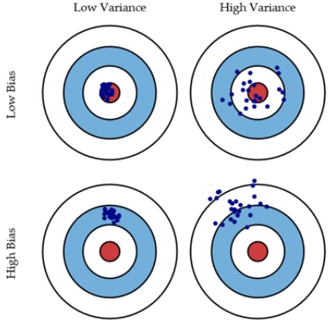
Bias and Variance in regression models
The prediction error for any machine learning algorithm can be broken down into three parts:
Bias Error
Variance Error
Irreducible Error
The irreducible error cannot be reduced regardless of what algorithm is used. It is the error introduced from the chosen framing of the problem and may be caused by factors like unknown variables that influence the mapping of the input variables to the output variable.
Low Bias: Suggests less assumptions about the form of the target function.
High-Bias: Suggests more assumptions about the form of the target function.
Low Variance: Suggests small changes to the estimate of the target function with changes to the training dataset.
High Variance: Suggests large changes to the estimate of the target function with changes to the training dataset.

Slide 10
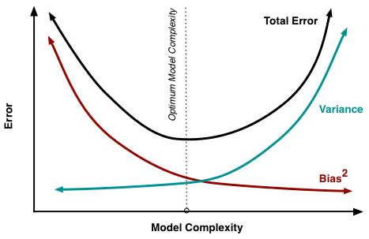
Bias-Variance Trade-Off
The goal of any supervised machine learning algorithm is to achieve low bias and low variance. In turn the algorithm should achieve good prediction performance.
Parametric or linear machine learning algorithms often have a high bias but a low variance.
Non-parametric or non-linear machine learning algorithms often have a low bias but a high variance.
The parameterization of machine learning algorithms is often a battle to balance out bias and variance.

Slide 11
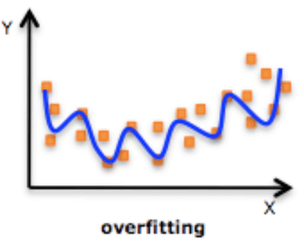
Regularized Linear Regression
One of the major aspects of training your machine learning model is avoiding overfitting. The model will have a low accuracy if it is overfitting. This happens because your model is trying too hard to capture the noise in your training dataset.
Regularization
This is a form of regression, that constrains/ regularizes or shrinks the coefficient estimates towards zero. In other words, this technique discourages learning a more complex or flexible model, so as to avoid the risk of overfitting.

Slide 12
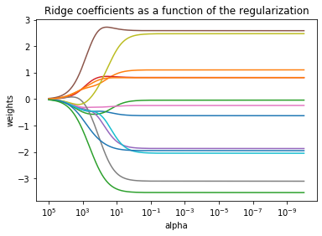
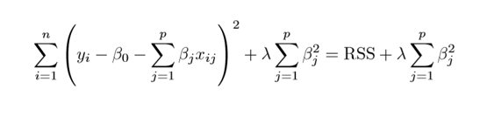
Ridge Regression
RSS is modified by adding the shrinkage quantity.
Now, the coefficients are estimated by minimizing this function. Here, λ is the tuning parameter that decides how much we want to penalize the flexibility of our model.
The increase in flexibility of a model is represented by increase in its coefficients, and if we want to minimize the above function, then these coefficients need to be small.

Slide 13
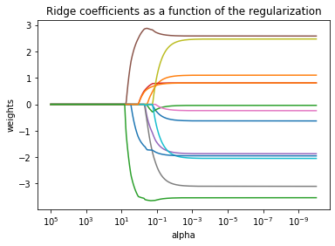
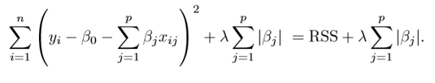
Lasso Regression
Lasso is another variation, in which the above function is minimized. Its clear that
this variation differs from ridge regression only in penalizing the high coefficients.

Slide 14
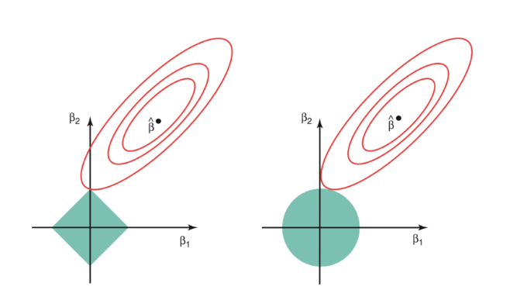
Regularized Linear Regression
The ridge regression is expressed by β1² + β2² ≤ s. This implies that ridge regression coefficients have the smallest RSS(loss function) for all points that lie within the circle given by β1² + β2² ≤ s
The lasso, the equation becomes,|β1|+|β2|≤ s. This implies that lasso coefficients have the smallest RSS(loss function) for all points that lie within the diamond given by |β1|+|β2|≤ s.

Slide 15
Model Evaluation
A confusion matrix shows the number of correct and incorrect predictions made by the classification model compared to the actual outcomes (target value) in the data. The matrix is NxN, where N is the number of target values (classes). Performance of such models is commonly evaluated using the data in the matrix. The following table displays a 2x2 confusion matrix for two classes (Positive and Negative).
Confusion Matrix | Target
 | Positive | Negative
Positive | a | b | Positive Predictive Value | a/(a+b)
Negative | c | d | Negative Predictive Value | d/(c+d)
 | Sensitivity | Specificity | Accuracy = (a+d)/(a+b+c+d)
Accuracy : the proportion of the total number of predictions that were correct.
Positive Predictive Value or Precision : the proportion of positive cases that were correctly identified.
Negative Predictive Value : the proportion of negative cases that were correctly identified.
Sensitivity or Recall : the proportion of actual positive cases which are correctly identified.
Specificity : the proportion of actual negative cases which are correctly identified.

Slide 16
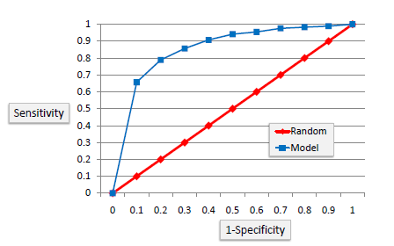
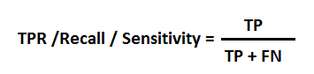
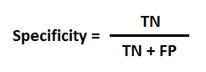
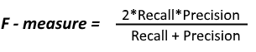
Model Evaluation
ROC Curves summarize the trade-off between the true positive rate and false positive rate for a predictive model using different probability thresholds
It’s often used as a proxy for the trade-off between the sensitivity of the model (true positives) vs the fall-out or the probability it will trigger a false alarm (false positives).
https://en.wikipedia.org/wiki/Confusion_matrix

Slide 17

Cross Validation
Cross-validation is a resampling technique used to evaluate machine learning models on a limited data set.
The most common use of cross-validation is the k-fold cross-validation method. Our training set is split into K partitions, the model is trained on K-1 partitions and the test error is predicted and computed on the Kth partition. This is repeated for each unique group and the test errors are averaged across.

Slide 18
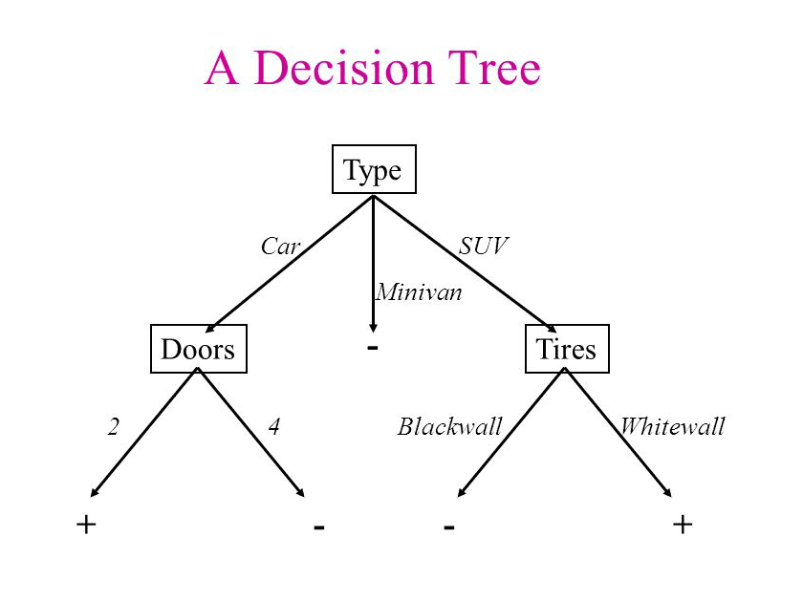
Decision Tree
Decision tree is the most powerful and popular tool for classification and prediction. A Decision tree is a flowchart like tree structure, where each internal node denotes a test on an attribute, each branch represents an outcome of the test, and each leaf node (terminal node) holds a class label.

Slide 19
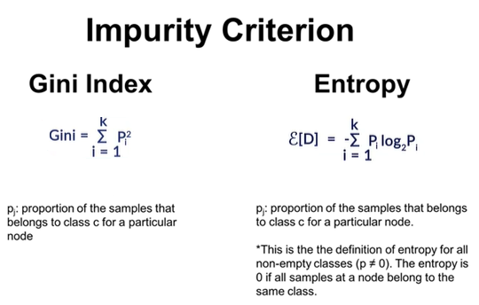
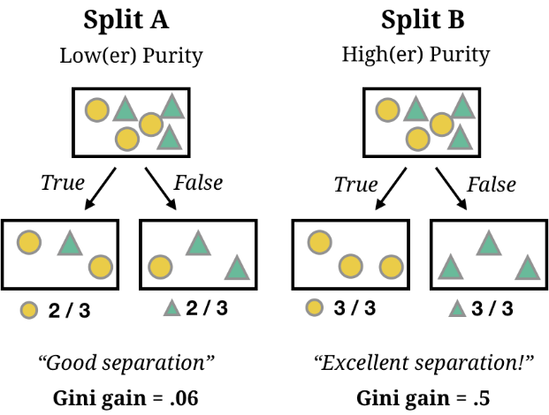
where to split ?

Slide 20
When to stop splitting?
As a problem usually has a large set of features, it results in large number of split, which in turn gives a huge tree. Such trees are complex and can lead to overfitting.
Pruning
Remove the branches that make use of features having low importance. This way, we reduce the complexity of tree, and thus increasing its predictive power by reducing overfitting.
Truncation
Stop the tree wile it is still growing so that it may not end up with leaves containing vary less data-points, one way to do this is by setting the minimum number

Slide 21
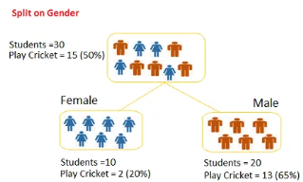
Poll 4
Question: we want to segregate the students based on target variable (playing cricket or not).we split the population using input variables Gender find the homogeneity of sub-nodes using Gini.
0.51
0.59
0.33
0.49
Practice in teams of 4 students
Industry expert mentoring to learn better
Get personalised feedback for improvements
16-07-2020
11

Slide 22
Poll 4 (Solution)
Question: we want to segregate the students based on target variable (playing cricket or not).we split the population using input variables Gender find the homogeneity of sub-nodes using Gini.
0.51
0.59
0.33
0.49
Practice in teams of 4 students
Industry expert mentoring to learn better
Get personalised feedback for improvements
Calculate, Gini for sub-node Female = (0.2)*(0.2)+(0.8)*(0.8)=0.68
Gini for sub-node Male = (0.65)*(0.65)+(0.35)*(0.35)=0.55
Calculate weighted Gini for Split Gender = (10/30)*0.68+(20/30)*0.55 = 0.59
16-07-2020
11

Slide 23
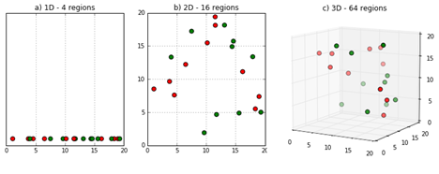
What is the curse of dimensionality?
Sparsity of data occurs when moving to higher dimensions. the volume of the space represented grows so quickly that the data cannot keep up and thus becomes sparse
The second issue that arises is related to sorting or classifying the data. In low dimensional spaces, data may seem very similar but the higher the dimension the data points may seem far.
Infinite Features Requires Infinite Training
A careful choice of the number of dimensions (features) to be used is the prerogative of the data scientist training the Model

Slide 24
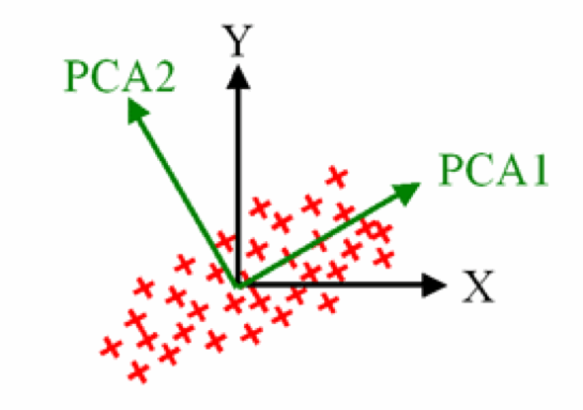
What is Principal Components Analysis?
Principal Components Analysis is an unsupervised learning class of statistical techniques used to explain data in high dimension using smaller number of variables called the principal components.
The loading vector Ф₁ with elements Ф₁₁, Ф₂₁,…,Ф_{p1} defines a direction in the feature space along which there is maximum variance in the data.
Thus, if we are to project the n data points x₁, x₂,…, x_{n}
onto this direction, then projected values are the actual principal component scores z₁₁, z₂₁, …, z_{n1}.
After the first principal components, Z₁ of the features has been determined, then the second principal component is the linear combination of X₁, ,X₂,… X_{p} that has the highest variance out of all the linear combinations that are uncorrelated with Z₁. The second principal component scores z₁₂, z₂₂,…,z_{n2} take the form

Slide 25
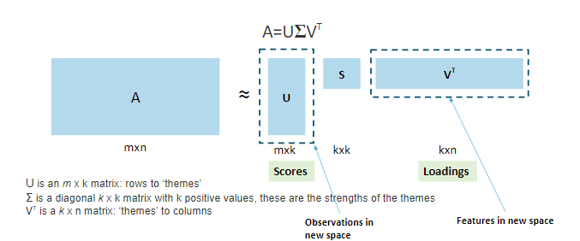
PCA
PCA is useful when you have a large number of potentially correlated variables. Also, PCA can be used to visualize complex datasets.
We saw that if each row in the original dataset A (m x n) represents a user and each column an item such as a book, then:
The matrix U (m x k) maps the users to the new k themes/latent variables
The diagonal matrix S (k x k) represents the strength of each feature
Matrix V' (k x n) maps each of the k themes/latent variables to the original n features.

Slide 26
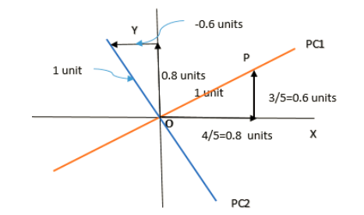
Poll 5
What are the PC1 and PC2 values for given x=3 and y=2 ?
3.4 & 1.2
3.6 & -0.2
3.4 & -0.2
3.6 & 1.2
Practice in teams of 4 students
Industry expert mentoring to learn better
Get personalised feedback for improvements
16-07-2020
11

Slide 27
Poll 5 (Answer)
What are the PC1 and PC2 values for given x=3 and y=2 ?
3.4 & 1.2
3.6 & -0.2
3.4 & -0.2
3.6 & 1.2
Practice in teams of 4 students
Industry expert mentoring to learn better
Get personalised feedback for improvements
16-07-2020
11

Slide 28
CLUSTERING
K-Mean Clustering
The number of clusters that you want to divide your data points into, i.e. the value of K has to be pre-determined.
The choice of the initial cluster centers can have an impact on the final cluster formation.
The clustering process is very sensitive to the presence of outliers in the data.
Since the distance metric used in the clustering process is the Euclidean distance, you need to bring all your attributes on the same scale. This can be achieved through standardization.
The K-Means algorithm does not work with categorical data.
Choosing the number of clusters K
Elbow method
Compute clustering algorithm (e.g., k-means clustering) for different values of k. For instance, by varying k from 1 to 10 clusters.
For each k, calculate the total within-cluster sum of square (wss)
Plot the curve of wss according to the number of clusters k.
The location of a bend (knee) in the plot is generally considered as an indicator of the appropriate number of clusters.

Slide 29
CLUSTERING
Hierarchical Clustering algorithm
Given a set of N items to be clustered, the steps in the hierarchical clustering are:
Calculate the NxN distance (similarity) matrix, which calculates the distance of each data point from the other.
Start by assigning each item to its own cluster, so that if you have N items, you now have N clusters, each containing just one item.
Find the closest (most similar) pair of clusters and merge them into a single cluster, so that now you have one less cluster.
Compute distances (similarities) between the new cluster and each of the old clusters.
Repeat steps 3 and 4 until all items are clustered into a single cluster of size N
Single Linkage
Here, the distance between 2 clusters is defined as the shortest distance between points in the two clusters
Complete Linkage
Here, the distance between 2 clusters is defined as the maximum distance between any 2 points in the clusters
Average Linkage
Here, the distance between 2 clusters is defined as the average distance between every point of one cluster to every other point of the other cluster.

Slide 30
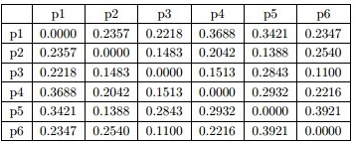
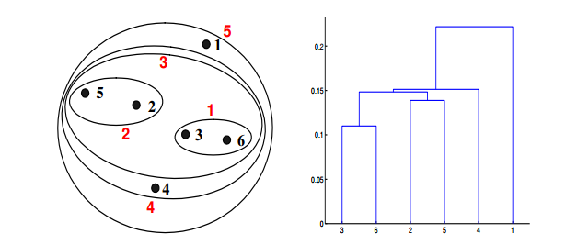
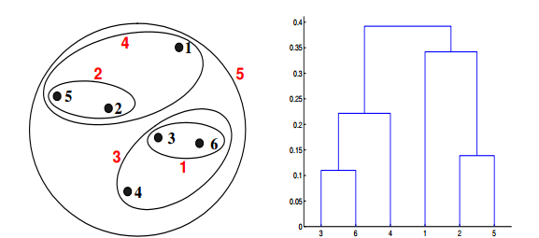
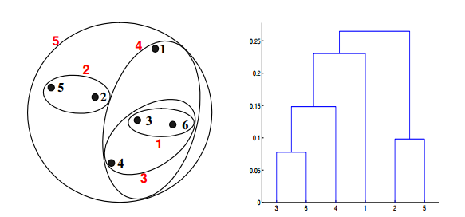
Poll 6
Which of the following clustering representations and dendrogram depicts the use of MIN or Single link proximity function in hierarchical clustering?
Distance Matrix
Practice in teams of 4 students
Industry expert mentoring to learn better
Get personalised feedback for improvements
(A)
(B)
(C)
16-07-2020
11

Slide 31
Poll 6 (Answer)
Which of the following clustering representations and dendrogram depicts the use of Single link proximity function in hierarchical clustering?
Distance Matrix
Practice in teams of 4 students
Industry expert mentoring to learn better
Get personalised feedback for improvements
(A)
(B)
(C)
16-07-2020
11

Slide 32
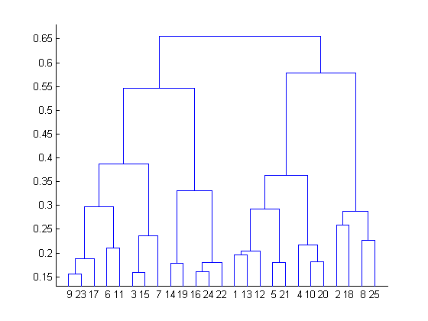
Poll 7
What is the most appropriate no. of clusters for the data points represented by the following dendrogram?
A. 2
B. 4
C. 6
D. 8
Practice in teams of 4 students
Industry expert mentoring to learn better
Get personalised feedback for improvements
16-07-2020
11

Slide 33
Poll 7 (Answer)
What is the most appropriate no. of clusters for the data points represented by the following dendrogram?
A. 2
B. 4
C. 6
D. 8
Practice in teams of 4 students
Industry expert mentoring to learn better
Get personalised feedback for improvements
16-07-2020
11

Slide 34
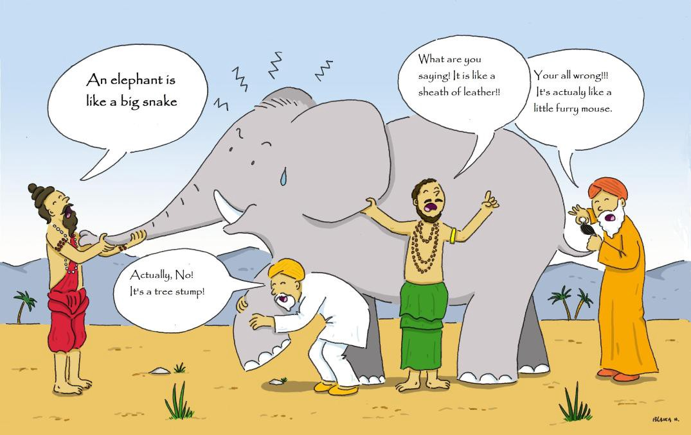
Ensemble methods
Ensemble learning is a machine learning paradigm where multiple models (often called “weak learners”) are trained to solve the same problem and combined to get better results.
https://towardsdatascience.com/ensemble-methods-bagging-boosting-and-stacking-c9214a10a205

Slide 35
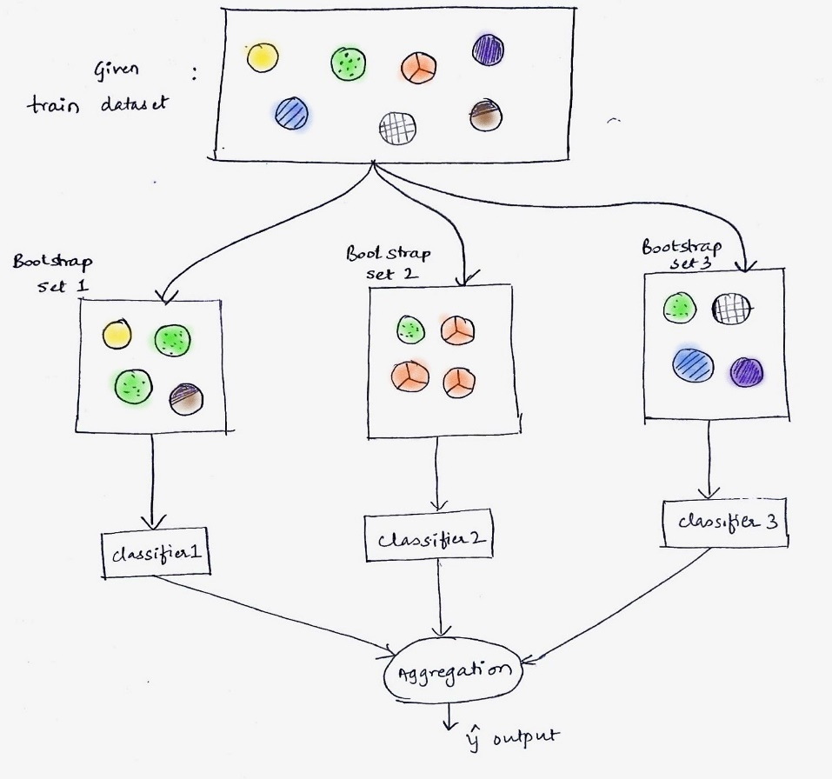
Bagging
Bagging, that often considers homogeneous weak learners, learns them independently from each other in parallel and combines them following some kind of deterministic averaging process
https://learn.upgrad.com/v/course/515/session/77070/segment/431269

Slide 36
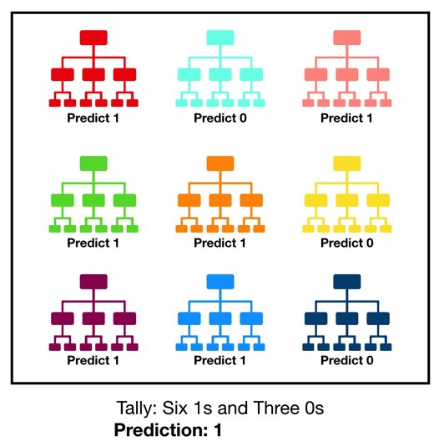
Random Forest
Random forest, like its name implies, consists of a large number of individual decision trees that operate as an ensemble. Each individual tree in the random forest spits out a class prediction and the class with the most votes becomes our model’s prediction
The reason for this wonderful effect is that the trees protect each other from their individual errors (as long as they don’t constantly all err in the same direction)

Slide 37
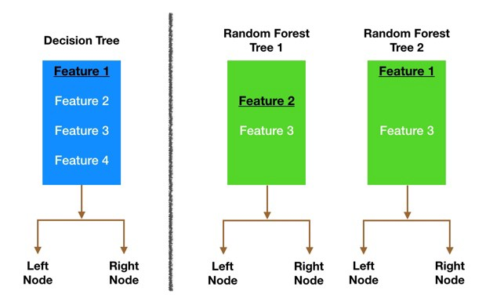
Random Forest
Bagging (Bootstrap Aggregation) — Decision trees are very sensitive to the data they are trained on — small changes to the training set can result in significantly different tree structures. Random forest takes advantage of this by allowing each individual tree to randomly sample from the dataset with replacement, resulting in different trees.
Feature Randomness — In a normal decision tree, while splitting a node, we consider all the features and pick the one that produces the most separation. In contrast, each tree in a random forest can pick only from a random subset of features. This forces even more variation amongst the trees in the model and ultimately results in lower correlation across trees and more diversification.

Slide 38
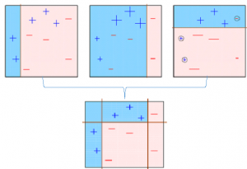
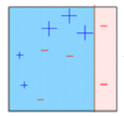
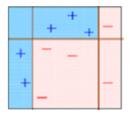
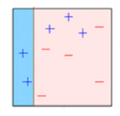
Different ensemble methods
The observations which are incorrectly predicted, are given higher weights and an another model is created and predictions are made on the dataset
Base model is created on a subset
. The individual models would not perform well on the entire dataset, but they work well for some part of the dataset. Thus, each model actually boosts the performance of the ensemble.
multiple models are created, each correcting the errors of the previous model.
The final model (strong learner)
Boosting, that often considers homogeneous weak learners, learns them sequentially in a very adaptive way (a base model depends on the previous ones) and combines them following a deterministic strategy
https://medium.com/mlreview/gradient-boosting-from-scratch-1e317ae4587d

Slide 39

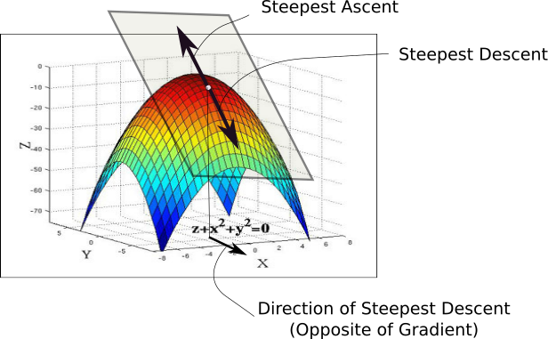
Gradient Descent
While the direction of the gradient tells us which direction has the steepest ascent, it's magnitude tells us how steep the steepest ascent/descent is. So, at the minima, where the contour is almost flat, you would expect the gradient to be almost zero. In fact, it's precisely zero for the point of minima.
Gradient descent is an optimization algorithm used to minimize some function by iteratively moving in the direction of steepest descent as defined by the negative of the gradient

Slide 40

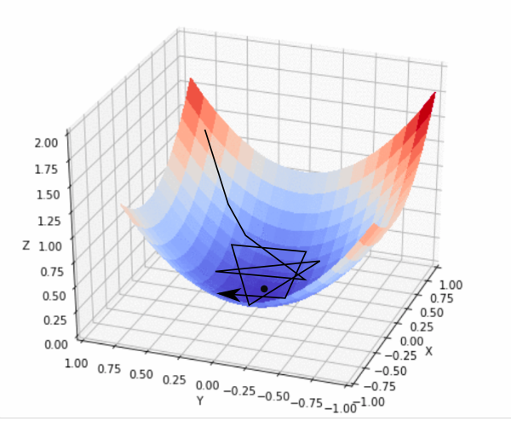
Gradient Descent
In practice, we might never exactly reach the minima, but we keep oscillating in a flat region in close vicinity of the minima. As we oscillate our this region, the loss is almost the minimum we can achieve, and doesn't change much as we just keep bouncing around the actual minimum. Often, we stop our iterations when the loss values haven't improved in a pre-decided number, say, 10, or 20 iterations. When such a thing happens, we say our training has converged, or convergence has taken place.

Slide 41
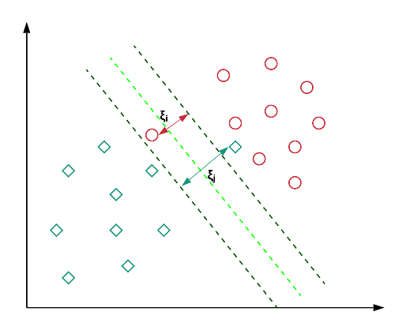
SUPPORT VECTOR MACHINES
Maximal Margin Classifier
Creates the best separating line that maintains the largest possible equal distance from the nearest points of both the classes
Maximal Margin Classifier has certain limitations. For instance, it will not find a separator if the classes are not linearly separable
Soft Margin Classifier
The Soft Margin Classifier overcomes the drawbacks of the Maximal Margin Classifier by allowing certa1in points to be misclassified. You control the amount of misclassifications using the cost of misclassification 'C', where C is the maximum value of the summation of the slack variable epsilon(ϵ)
i.e. ∑ϵi ≤ C

Slide 42
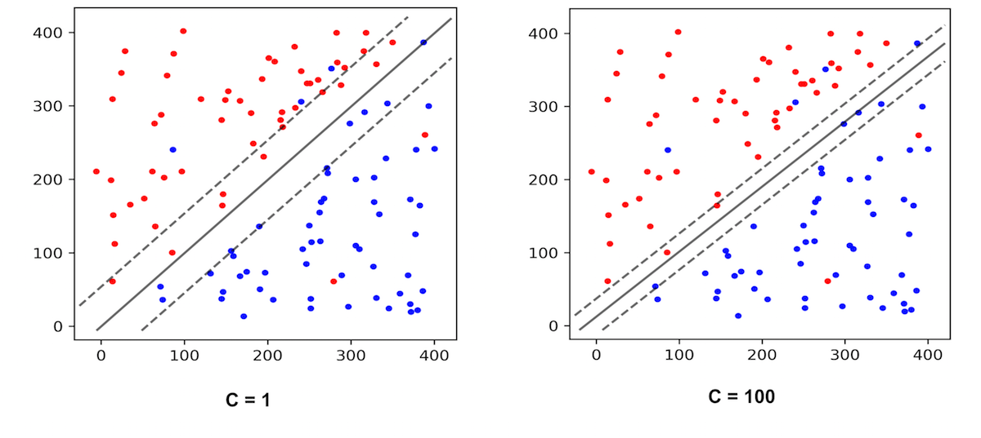
SUPPORT VECTOR MACHINES
If C is high, a higher number of points are allowed to be misclassified or violate the margin. In this case, the model is flexible, more generalizable, and less likely to overfit. In other words, it has a high bias.
On the other hand, if C is low, a lesser number of points are allowed to be misclassified or violate the margin. In this case, the model is less flexible, less generalizable, and more likely to overfit. In other words, it has a high variance.
∑ϵi ≤ C

Slide 43

SUPPORT VECTOR MACHINES
not all data are linearly separable. In fact, in the real world, almost all the data are randomly distributed, which makes it hard to separate different classes linearly.
https://medium.com/@zxr.nju/what-is-the-kernel-trick-why-is-it-important-98a98db0961d

Slide 44
Poll 3
The effectiveness of an SVM depends upon?
Selection of Kernel
Kernel Parameters
Soft Margin Parameter C
All of the above
Practice in teams of 4 students
Industry expert mentoring to learn better
Get personalised feedback for improvements
16-07-2020
11

Slide 45
Poll 3(Answer)
The effectiveness of an SVM depends upon?
Selection of Kernel
Kernel Parameters
Soft Margin Parameter C
All of the above
Practice in teams of 4 students
Industry expert mentoring to learn better
Get personalised feedback for improvements
16-07-2020
11

Slide 46
Poll 4
Support vectors are the data points that lie closest to the decision surface?
TRUE
FALSE
Practice in teams of 4 students
Industry expert mentoring to learn better
Get personalised feedback for improvements
16-07-2020
11

Slide 47
Poll 4 (Answer)
Support vectors are the data points that lie closest to the decision surface?
TRUE
FALSE
Practice in teams of 4 students
Industry expert mentoring to learn better
Get personalised feedback for improvements
16-07-2020
11

Slide 48

#LifeKoKaroLift
Thank You!

